Slide 1
Problem#1
Reliable communication over noisy channel
Consider the following symmetric binary channel:
10.000 bits are considered to be sent toward the destination. Calculate the number of errors and its fluctuation.
0
1-f
0
f
1
1
1-f
Notes:
“复用multiplexing ”是通信技术中常用的名词，是指能在同一传输媒质中同时传输多路信号的技术，目的提高通信线路的利用率。常用的方式有频分复用、时分复用、码分复用CDM等

Slide 2
Problem#2
Source Data:
0
1
1
0
Replication:
000
111
111
000
Noise:
010
100
101
001
Received
Replicated
Data:
010
011
010
001
Results
in receiver’s
Side:
0
1
0
0
Notes:
“复用multiplexing ”是通信技术中常用的名词，是指能在同一传输媒质中同时传输多路信号的技术，目的提高通信线路的利用率。常用的方式有频分复用、时分复用、码分复用CDM等

Slide 3
Transceiver Structure:
Communications Block Diagram
Information
Source
Source
Encoder
Channel
Encoder
Modulator
Channel
(Physical Media)
Noise
Information
Destination
Source
Decoder
Channel
Decoder
Demodulator

Slide 4
Digital Modulation
Modulation of digital signals known as Shift Keying
  Amplitude Shift Keying (ASK):
    very simple
    low bandwidth requirements
    very susceptible to interference
  Frequency Shift Keying (FSK):
    needs larger bandwidth
  Phase Shift Keying (PSK):
    more complex
    robust against interference
1
0
1
t
1
0
1
t
1
0
1
t
2.22.1

Slide 5
What’s multiplexing？
Capacity of transmission medium usually exceeds capacity required for transmission of a single signal
Multiplexing - carrying multiple signals on a single medium and then recovering the separate signals at the receiving end
  More efficient use of transmission medium
Notes:
“复用multiplexing ”是通信技术中常用的名词，是指能在同一传输媒质中同时传输多路信号的技术，目的提高通信线路的利用率。常用的方式有频分复用、时分复用、码分复用CDM等

Slide 6
Multiplexing Techniques
Multiplexing in 4 dimensions
  time (t)
  frequency (f)
  code (c)
  space (s_{i})
Goal: multiple use
of a shared medium
Important: guard spaces needed!
channels k_{i}
k₁
k₂
k₃
k₄
k₅
k₆
c
t
c
s₁
t
s₂
f
f
c
t
s₃
f

Slide 7
Frequency Division Multiplexing
Separation of the whole spectrum into smaller frequency bands
A channel gets a certain band of the spectrum for the whole time
Advantages:
  no dynamic coordination
  necessary
  works also for analog signals
Disadvantages:
  waste of bandwidth
  if the traffic is
  distributed unevenly
  inflexible
  guard spaces
k₁
k₂
k₃
k₄
k₅
k₆
c
f
t
2.16.1

Slide 8
Time Division Multiplexing
A channel gets the whole spectrum for a certain amount of time
Advantages:
  only one carrier in the medium at any time
  throughput high even for many users
Disadvantages:
  precise
  synchronization is
  necessary
k₁
k₂
k₃
k₄
k₅
k₆
c
f
t
2.17.1

Slide 9
Time and Frequency Division Multiplexing
Combination of both methods
A channel gets a certain frequency band for a certain amount of time
Example: GSM
Advantages:
  better protection against
  tapping
  protection against frequency
  selective interference
  higher data rates compared to
  code multiplex
but: precise coordination
required
k₁
k₂
k₃
k₄
k₅
k₆
c
f
t

Slide 10
Code Division Multiplexing
Each channel has a unique code
All channels use the same spectrum at the same time
Advantages:
  bandwidth efficient
  no coordination and synchronization necessary
  good protection against interference
Disadvantages:
  lower user data rates
  more complex signal regeneration
Implemented using spread spectrum technology
k₁
k₂
k₃
k₄
k₅
k₆
c
f
t

Slide 11
Spread Spectrum
Two Kinds
Direct Sequence
  Each bit is represented by multiple bits in transmitted signal
  Chipping code: each user uses different orthogonal PN sequence
Frequency hoping
  Signal broadcast over seemingly random series of frequencies

Slide 12

Direct Sequence Spread Spectrum (DSS)

Slide 13

DSS Example

Slide 14
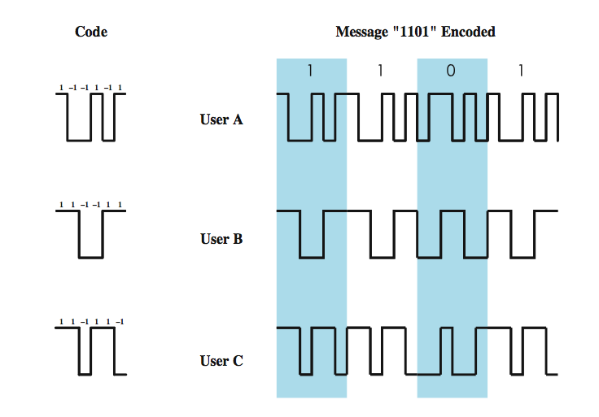
CDMA Example
Notes:
As an illustration we consider a simple example with k = 6. It is simplest to characterize a chipping code as a sequence of 1s and –1s. Figure 9.10 shows the codes for three users, A, B, and C, each of which is communicating with the same base station receiver, R. Thus, the code for user A is c_{A} = <1, –1, –1, 1, –1, 1>. Similarly, user B has code c_{B} = <1, 1, –1, –1, 1, 1>, and user C has c_{C} = <1, 1, –1, 1, 1, –1>. We now consider the case of user A communicating with the base station. The base station is assumed to know A’s code. For simplicity, we assume that communication is already synchronized so that the base station knows when to look for codes. If A wants to send a 1 bit, A transmits its code as a chip pattern <1, –1, –1, 1, –1, 1>. If a 0 bit is to be sent, A transmits the complement (1s and –1s reversed) of its code, <–1, 1, 1, –1, 1, –1>.
At the base station the receiver decodes the chip patterns. If the decoder is linear and if A and B transmit signals s_{A} and s_{B}, respectively, at the same time, then S_{A} (s_{A} + s_{B}) = S_{A} (s_{A}) + S_{A} (s_{B}) = S_{A} (s_{A}) since the decoder ignores B when it is using A’s code. The codes of A and B that have the property that S_{A} (c_{B}) = S_{B} (c_{A}) = 0 are called orthogonal. Using the decoder, S_{u}, the receiver can sort out transmission from u even when there may be other users broadcasting in the same cell. In practice, the CDMA receiver can filter out the contribution from unwanted users or they appear as low-level noise. However, if there are many users competing for the channel with the user the receiver is trying to listen to, or if the signal power of one or more competing signals is too high, perhaps because it is very near the receiver (the “near/far” problem), the system breaks down.

Slide 15
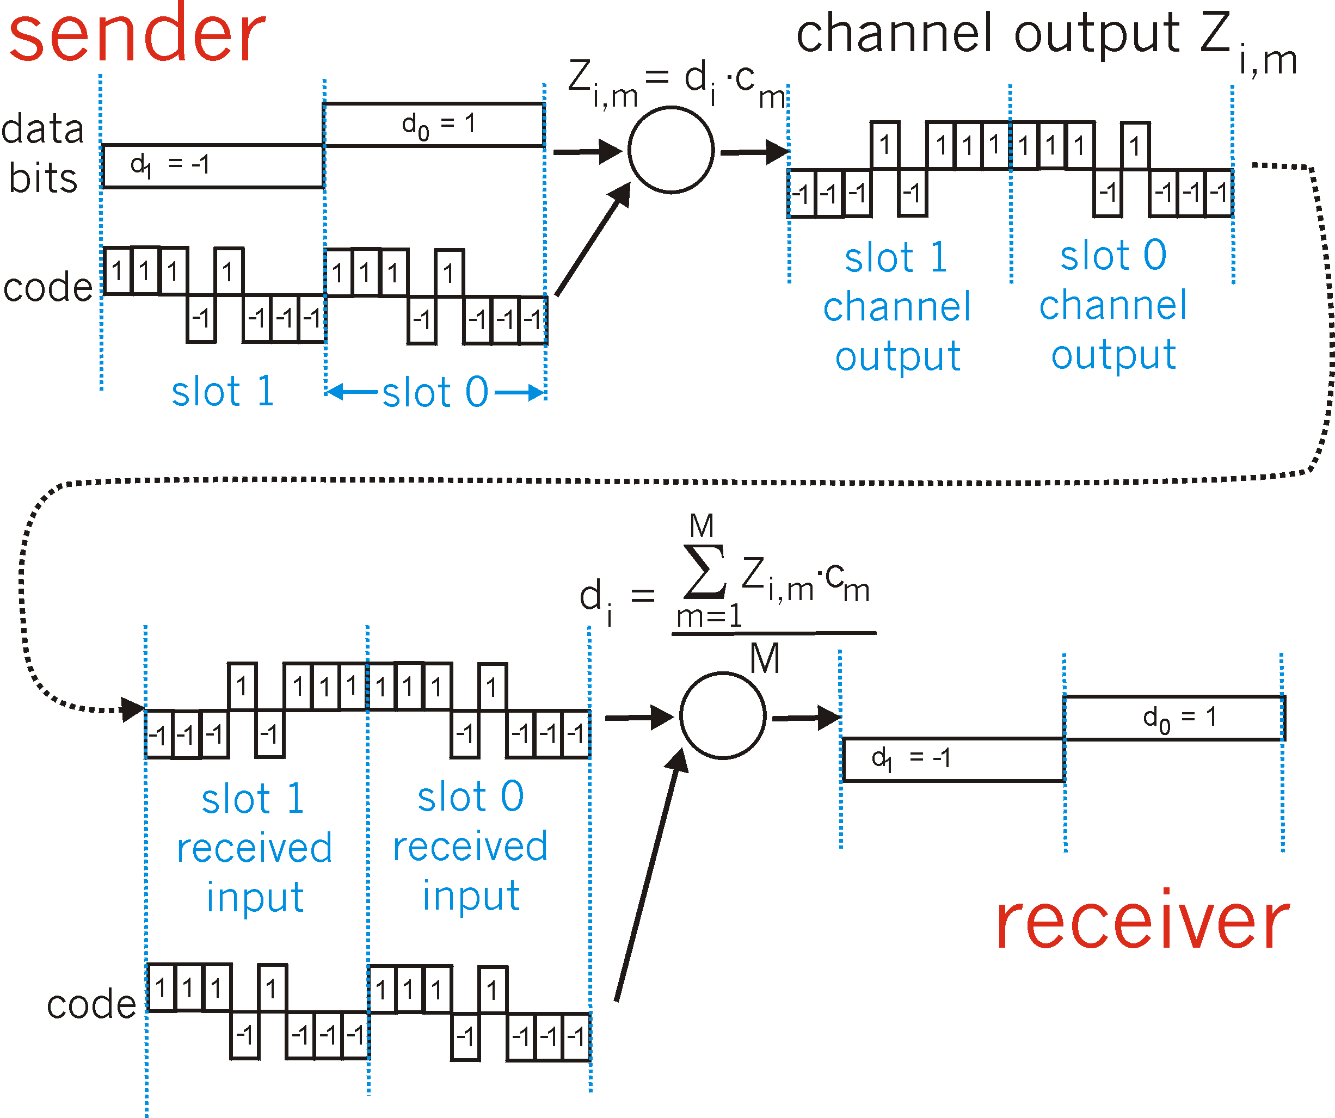
CDMA Encode/Decode

Slide 16
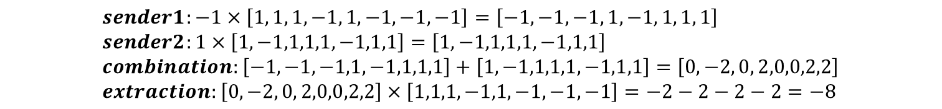

sender 1
sender 2
uses sender 1 code
to receive sender 1 data

